Slide 1
AI Driven Automated Software Testing

Slide 2
Contents
Introduction
Automated Software Testing Framework
AI Implementation

Slide 3
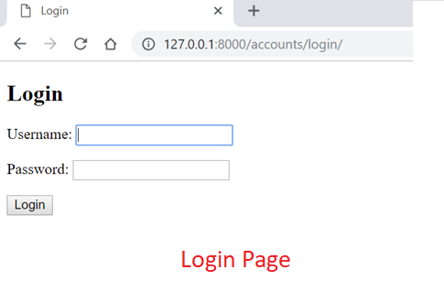
Introduction
A simple website is developed using Python Django for polling application.
When we enter the host server (127.0.0.1:8000, in this case), it opens the account login page.

Slide 4
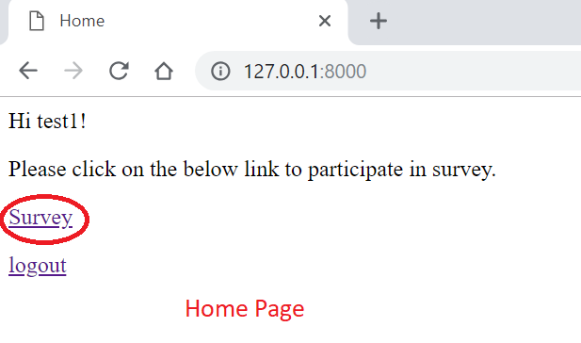
Introduction
After entering user id and password, it opens the home page with a link to survey. Please enter test1 as user id and djangowebdev1 as password.

Slide 5
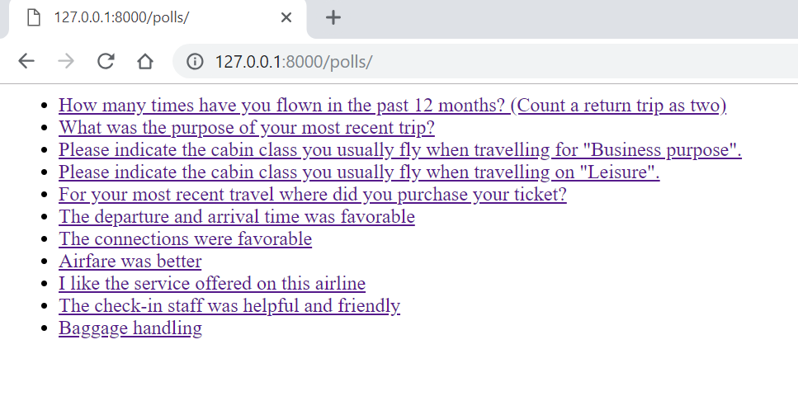
Introduction
When you click on the ‘Survey’ link, it opens the Questions page.

Slide 6
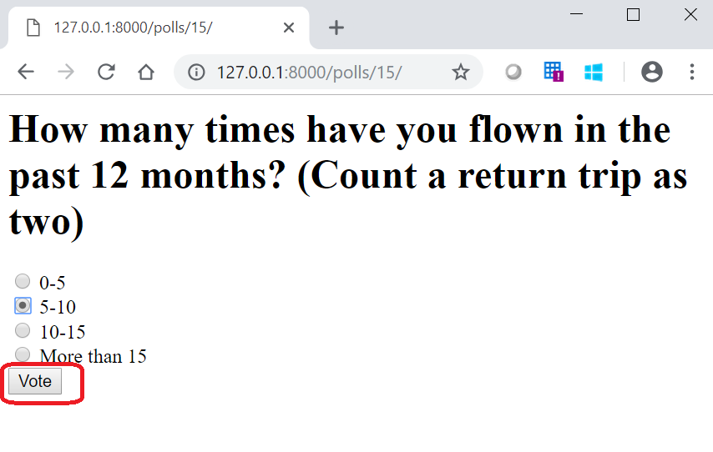
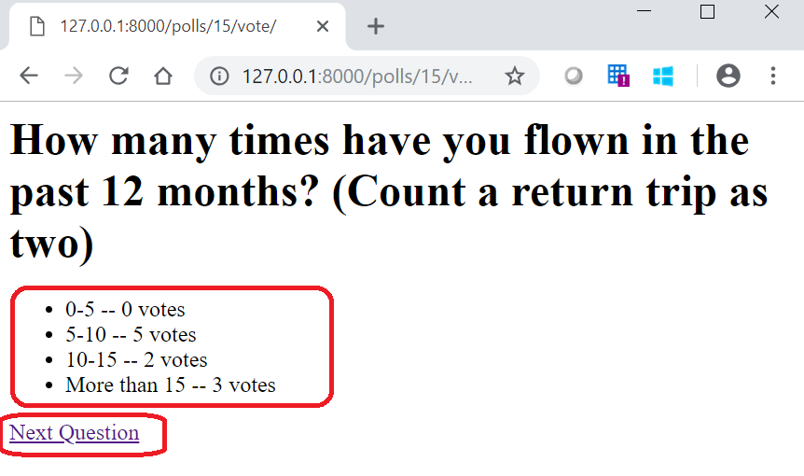
Introduction
You can select your option and then click in Vote.
It will show the poll results updated till date, and also show a link to open the Next Question.

Slide 7
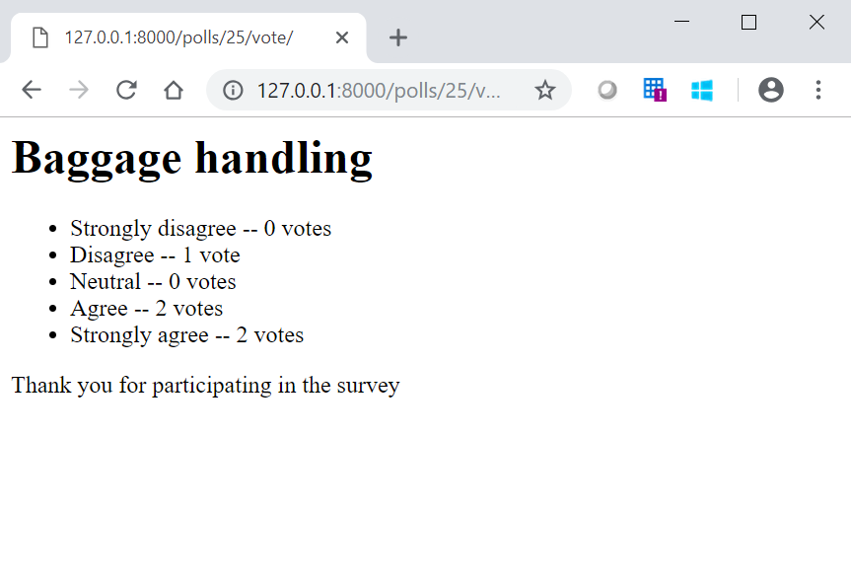
Introduction
Continue to all the poll questions until the last question.
After the last question, a thank you message along with the response/result for the last question.

Slide 8
Introduction
Continue to all the poll questions until the last question.
After the last question, a thank you message along with the response/result for the last question.

Slide 9
Automated Software Testing Framework
The tests are built to test models, views and application integration.
The ‘TestCase’ module is from django.test library.
Used ‘Model_Mommy’ library to create automated test cases.
Used ‘Coverage’ library to create a coverage report.
To test models: testing questions and choices.
To test views: testing Vote Views.
To test integration: testing end-to end of the application from creating a question with choices, voting and checking if votes are increasing for the selected choices.

Slide 10
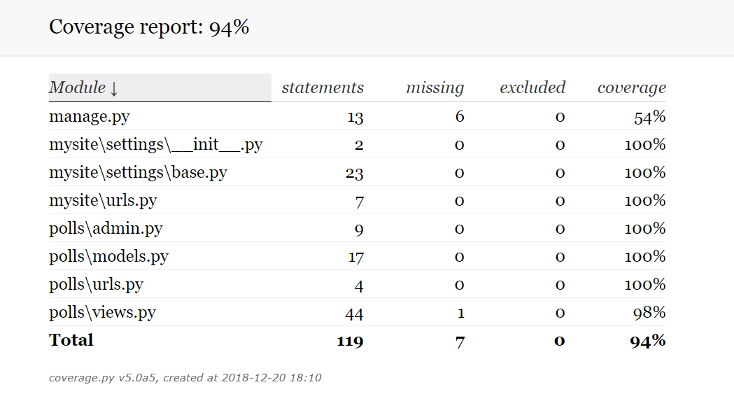
Automated Software Testing Framework
The coverage report for the tests included.

Slide 11
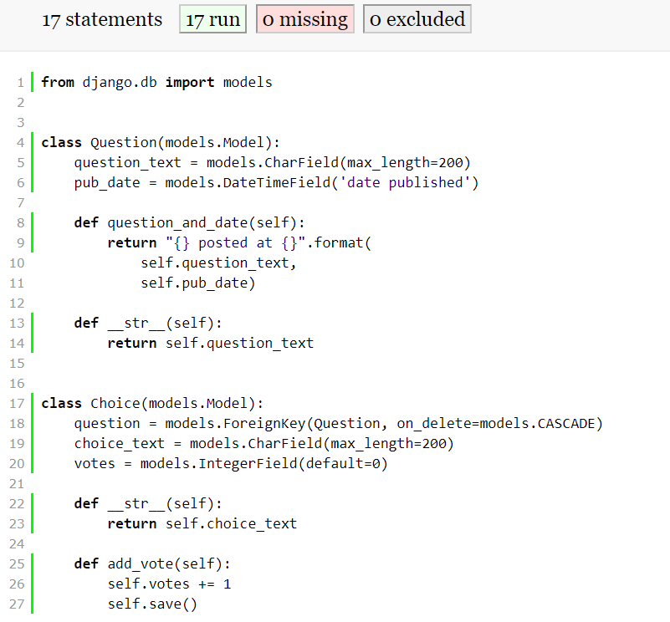
Automated Software Testing Framework
When you click any of the module, it will open a new window with detailed report.
It will also show the part of the code not covered in testing.

Slide 12
AI Implementation
Created a dummy historical data to capture questions, user, date and error results.
The error results– ‘Yes’ means there was some error in displaying that question to the said user.
There are a total of 56 observations.
Questions | User | Date | Error
How many times have you flown in the past 12 months? (Count a return trip as two) | test1 | 12/19/2018 | No

Slide 13
AI Implementation
A Logistic regression model was developed using the following features– Questions, Length of Question, day difference from today.
The output or target variable is the error results– ‘Yes’ or ‘No’.
For AI driven Software testing, we used a question selected at random from historical data with probability of error greater than 50%.
This will help us to test the system if the older issues are fixed and working properly.
The Codes are available at github.com/veeranalytics/AI_Software_Testing

